Slide 1
Colonialism in India
Dr. Md. Faruk Shah
Adjunct Faculty Member
Department of History and Philosophy
North South University

Slide 2
Indian Subcontinent
Location: Southern Asia
Mountains: Himalayas
Rivers: Brahmaputra, Ganges & Indus
Religions- Hinduism (Caste System), Islam, Buddhism, Christian,
Early Civilizations- Mohenjo Daro, Harappa
https://www.youtube.com/watch?v=zK_atT-MMUs

Slide 3
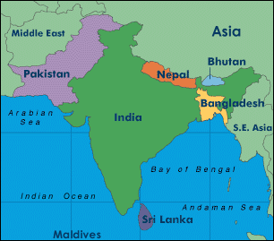
Nations:
India, Pakistan, Bangladesh, Bhutan, Nepal & Sri Lanka

Slide 4
British East India Company (1600) govt. chartered trading monopoly
  Received permission to trade from Mughal Empire
  Company had its own army(Sepoys)
  Decline of Mughals & Company controlled 3/5’s of India
  Exercised power usually associated with a government

Slide 5
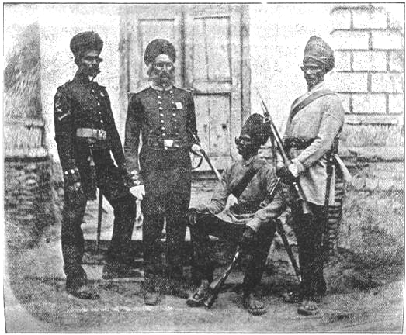
Sepoy Mutiny
Sepoys- Indian soldiers
  Felt British military rules were against religious beliefs
  1857 Hindus & Muslims to unite against British
  British crush revolt & ends company’s rule of India
  British government takes control of India

Slide 6
Cabinet minister in England directed policy
British Governor General (Viceroy) carried out government orders in India
British established a single law for everybody( All castes were equal)
Established English as the official language

Slide 7

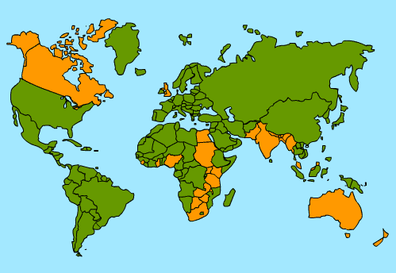
India was Jewel in the Crown of English Colonies
  300 million people: a huge potential market
  Major supplier of Raw materials (Cotton, opium)

Slide 8
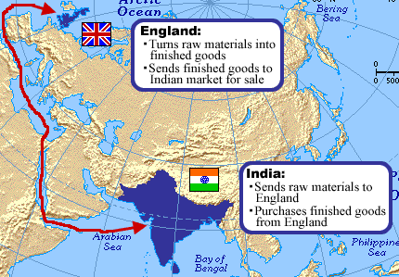

Slide 9

Positives of Imperialism
  Improved infrastructure, built schools, improved sanitation & public health, ended local warfare
  Indians allowed to study abroad

Slide 10

Negatives of Imperialim
  British held all political & economic power
  Indians treated as second class citizens
  Indian cultural values, beliefs & practices were threatened

Slide 11
Indian Nationalist movements
Ram Mohun Roy- Father of Modern India
  Moved India away from traditional ways (Ex. Wanted to end child marriages, widow suicide (suttee) etc.)
1885- Indian National Congress
1947- Independence & Partition

Slide 12
Neo-Colonialism
A form of indirect control over developing countries, most of them former colonies
Direct political control decreased whilst economic control increased.
Economic dependence
Economic dominance of multinational companies
Impact of foreign aid and foreign debt

Slide 13
How were they being indirectly controlled?
Aid
Often given with ‘strings attached’ forcing the developing countries to spend it in particular ways
2) Trade
Low raw material export prices contrast with high prices that developing countries have to pay for manufactured goods
3) Debt
Many developing countries pay huge sums of money to developed countries each year in interest

